Slide 1
Online Aptitude Test Portal
Under the guidance of
Mr.Mahendra
By Chiranjeevi

Slide 2
Contents:
Aim
Tools and Languages
Topics Learned
DataBase Design
Project Progress
Results

Slide 3
Aim:
Online Aptitude Test Portal requirements are:
Creating an admin and student logins different
The main controls of Admin are:
Preparing and Modifying a Question Paper
Monitoring the Student progress
Add students in the portal
The student has:
Student information
Test Instructions
Timer
Begin the Test
The Database consists of:
Admin and Student’s Login and Personal Details
Set of Questions
Set of Question Papers
Results of Students

Slide 4
Tools and Languages
Tools:
Eclipse IDE
Xampp
Languages:
HTML
CSS
Java

Slide 5
Topics Learned:
Creating HTML pages
Working of Eclipse IDE
Creating a web project in Eclipse IDE
How to use Servlet
Connecting to Online Server(Tomcat)
Working of JDBC
Creating a database and tables in it
Connecting Java application with Database

Slide 6
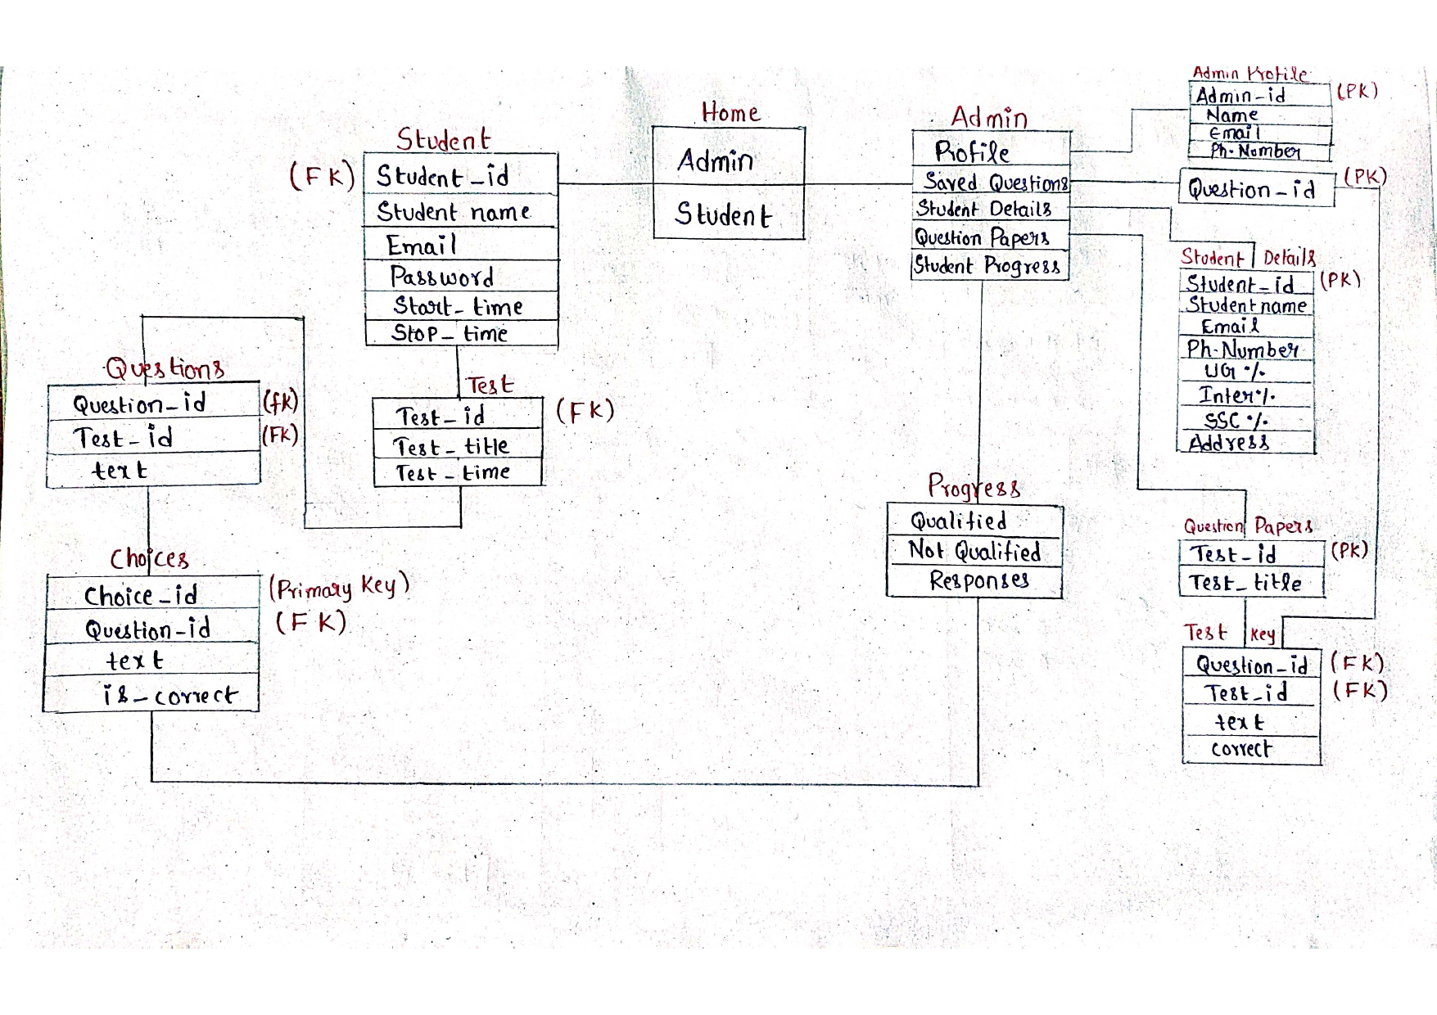
DataBase Design:

Slide 7
Project Progress:
Created a Web Project named Online Aptitude Test in Eclipse IDE
Created different classes named:
OAT Controller Class
OAT Bean Class
OAT Service Class
OAT DAO Class
OAT DBUtil Class
Created HTML pages for:
Index page
Admin login page
Student login page
Admin home page
Reset password page
Login fail and Sign Out page

Slide 8
Created a Database named Smallday using Xampp controller
Created tables for admin and student with data
Connected Tomcat v9.0 to Eclipse IDE
Downloaded mysql connector jar file and connected to Eclipse IDE
Generated connection between HTML pages and Database using
DB Util
Successfully the login pages of Admin and Student executed
After providing correct login details it redirects to the homepages

Slide 9
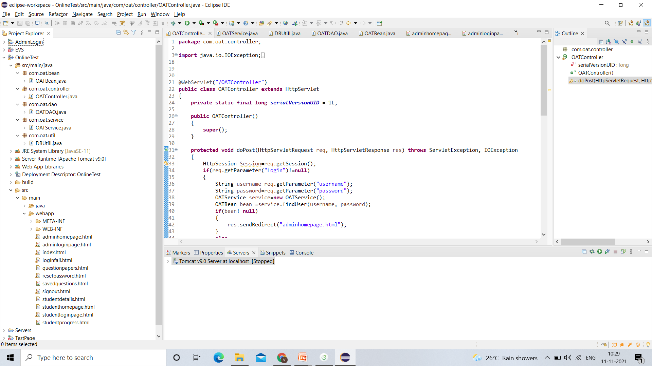
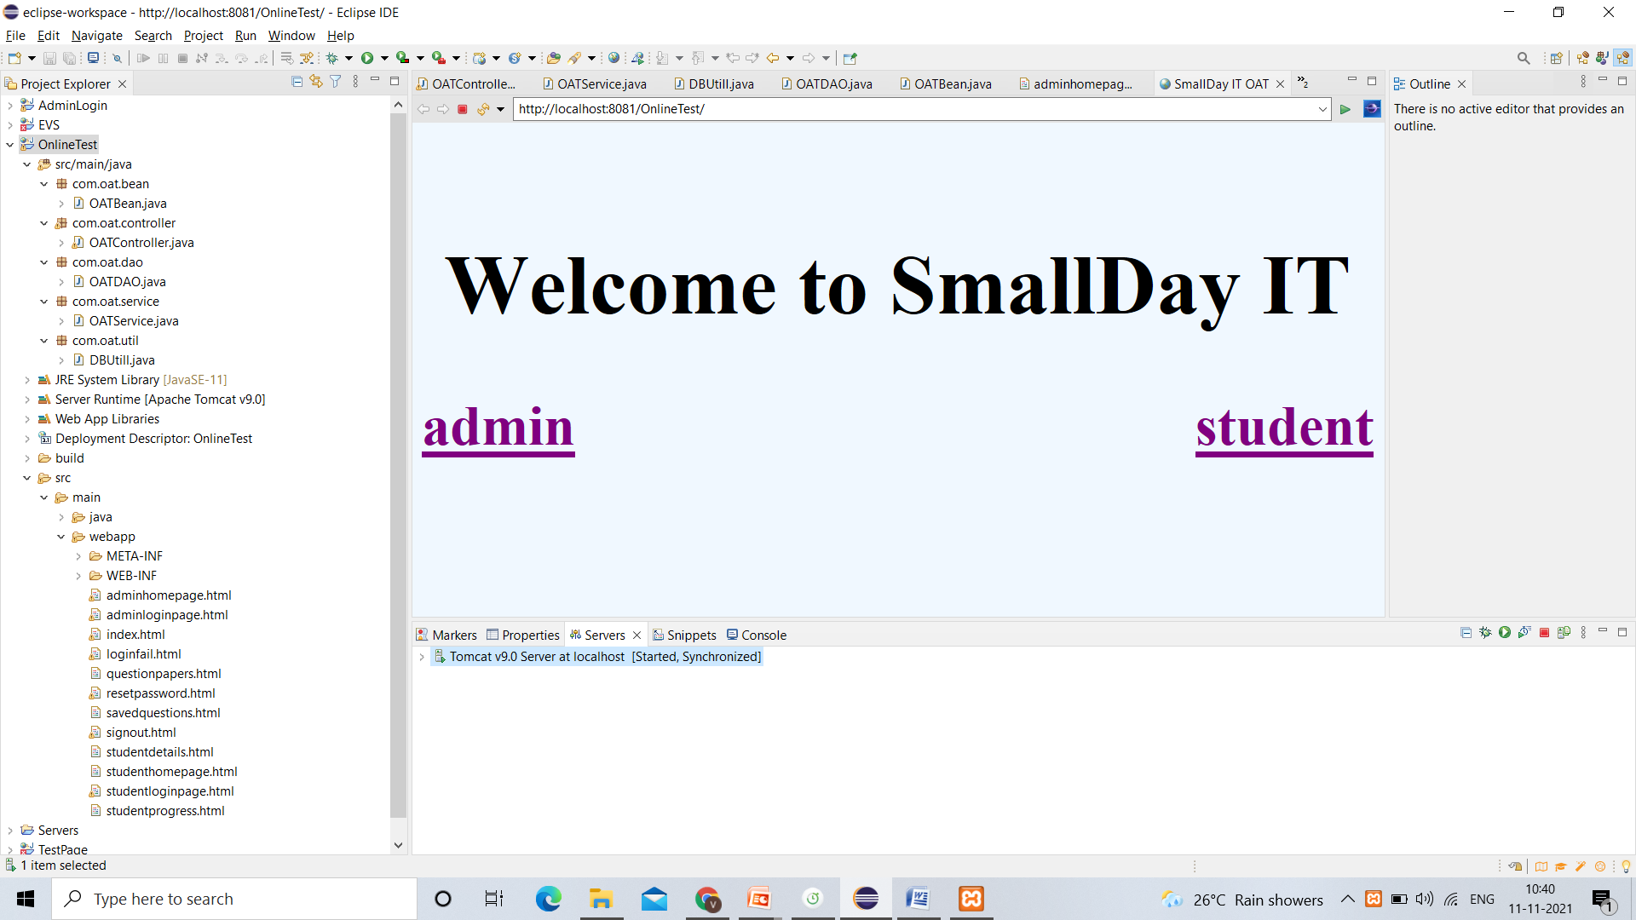
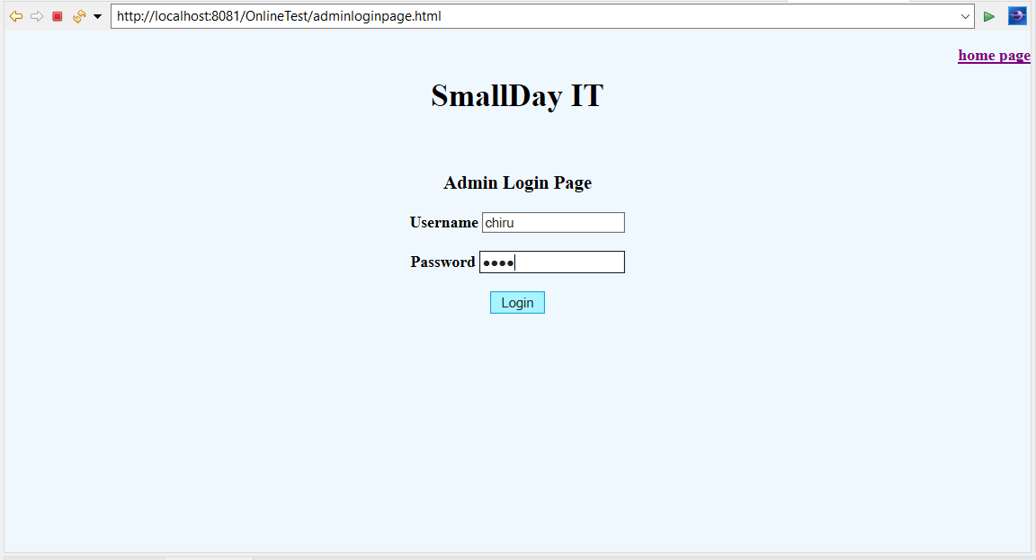
Results:

Slide 10
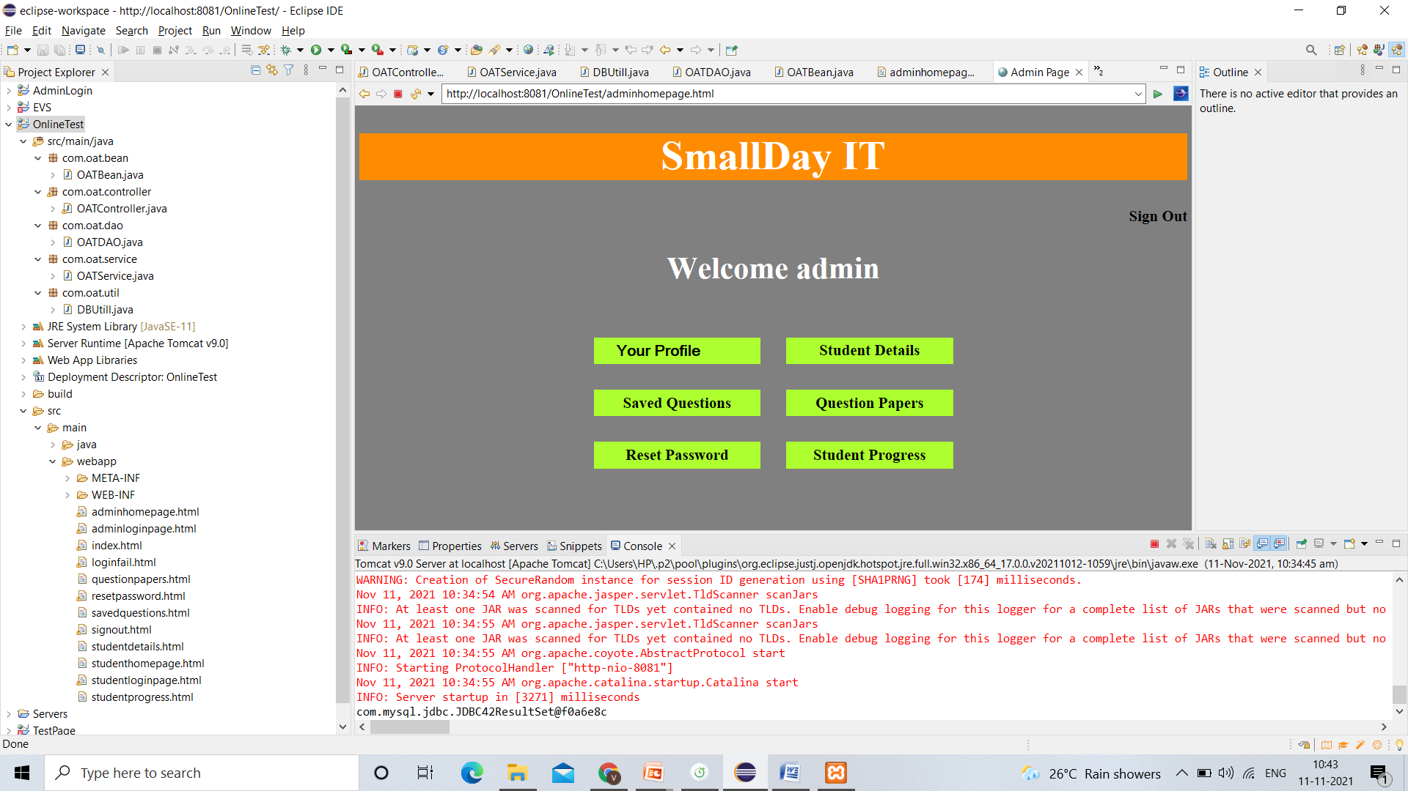
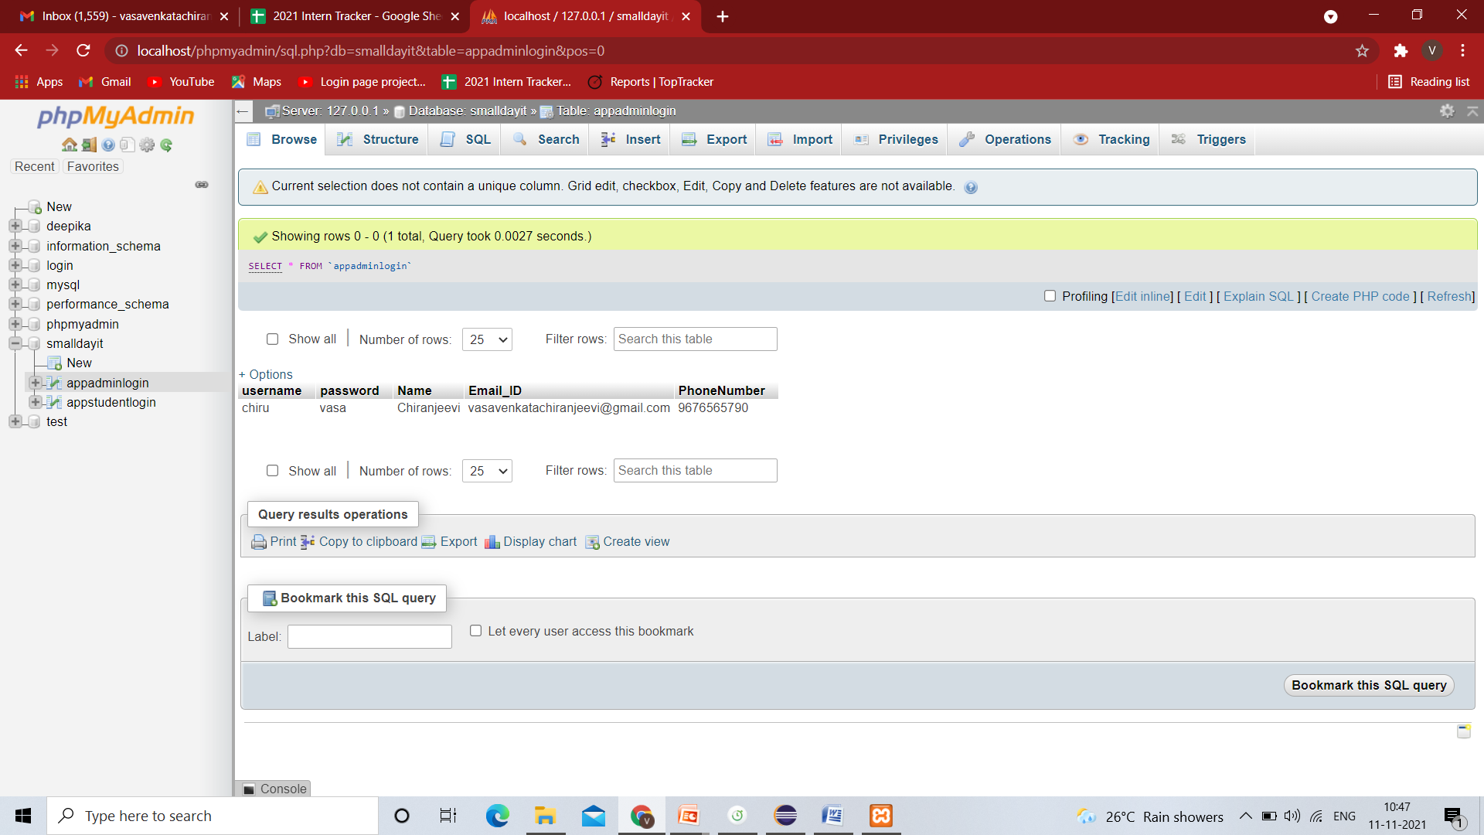
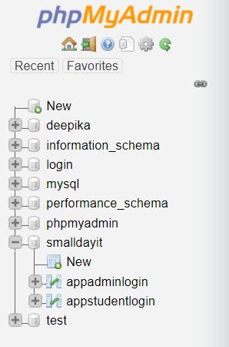
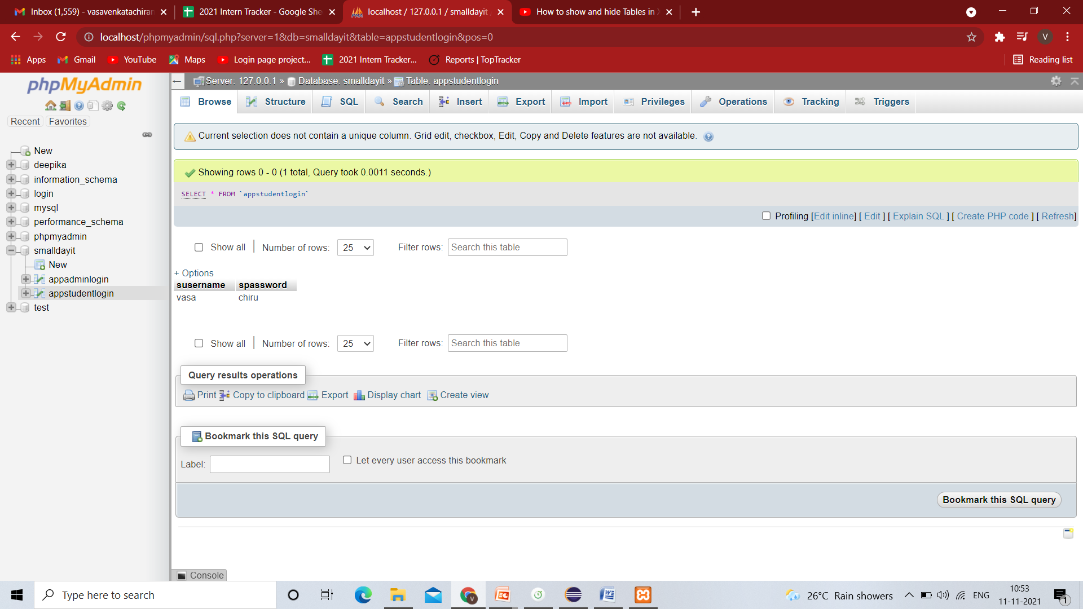

Slide 11

Thank You

